Slide 1

UNIX SHELL PROGRAMMING
THE PROCESS
PREETHI.P
Department of Computer Science and
Engineering

Slide 2

UNIX SHELL PROGRAMMING
THE PROCESS
PREETHI.P
Department of Computer Science and Engineering

Slide 3
UNIX SHELL PROGRAMMING
PROCESS CREATION
FORK, EXEC AND WAIT are the system calls or functions
Fork:
creates a copy of the process that invokes it.
new process image is practically identical – as calling process.
Except PID as child gets a new PID.

Slide 4
UNIX SHELL PROGRAMMING
PROCESS CREATION
EXEC:
Forked child creates a process but copies the same image as parents code.
To run a new program with new code and data --- Childs image is overwritten and the child is said to be exec.
No new process is created and holds same PID and PPID.
WAIT:
The parent uses wait system call to wait for child’s execution.

Slide 5
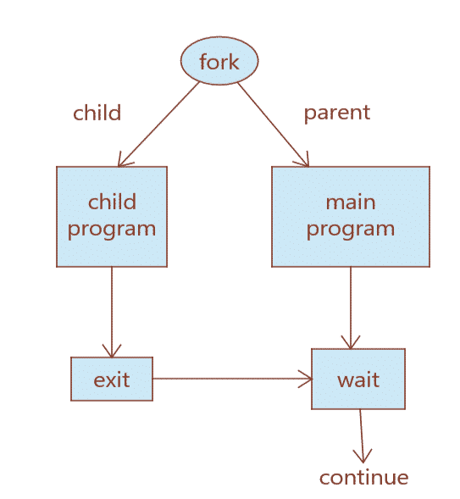
UNIX SHELL PROGRAMMING
PROCESS CREATION

Slide 6
UNIX SHELL PROGRAMMING
PROCESS CREATION
Inherited Attributes:
1.Real UID and real GID
2. Effective UID and GID
3. Current directory
4.Descriptors
5. Environment variables.

Slide 7
UNIX SHELL PROGRAMMING
PROCESS CREATION
Shell Creation :
Init -----→getty-------→login--------→shell
fork fork-exec fork-exec
Internal and External commands:
Built in commands are internal commands ex: cd, echo, assignment etc…
Unix utilities and programs are external commands. Cat, ls etc…

Slide 8
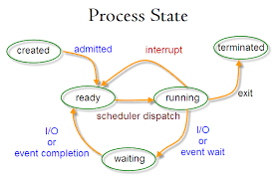
UNIX SHELL PROGRAMMING
PROCESS STATES
1. Runnable
2. Running
3. Sleeping
4. Suspended
5. Zombie
Image reference: techmint.com

Slide 9
UNIX SHELL PROGRAMMING
RUNNING JOBS IN BACKGROUND
1 & : To run a job in background
2. nohup: NO hang up
3. nice : priority
4. Kill
5. bg, fg, jobs, kill .

Slide 10
THANK YOU
PREETHI.P
Assistant Professor , Department of Computer Science
preethip@pes.edu

